Slide 1
MENTEES’ PERFORMANCE
&
MENTOR’S ACHIEVEMENT
NOPANY INSTITUTE OF MANAGEMENT STUDIES
2ND YEAR & 3RD YEAR STUDENTS
AS ON JANUARY 2023

Slide 2
OBJECTIVES OF THE ANALYSIS
To find out the potential students who can perform better;
To find out the best mentors

Slide 3
Techniques used
Data cleaning and software for analysis using Excel
Pivot Table
Pivot Chart
Presentation through Google slides

Slide 4
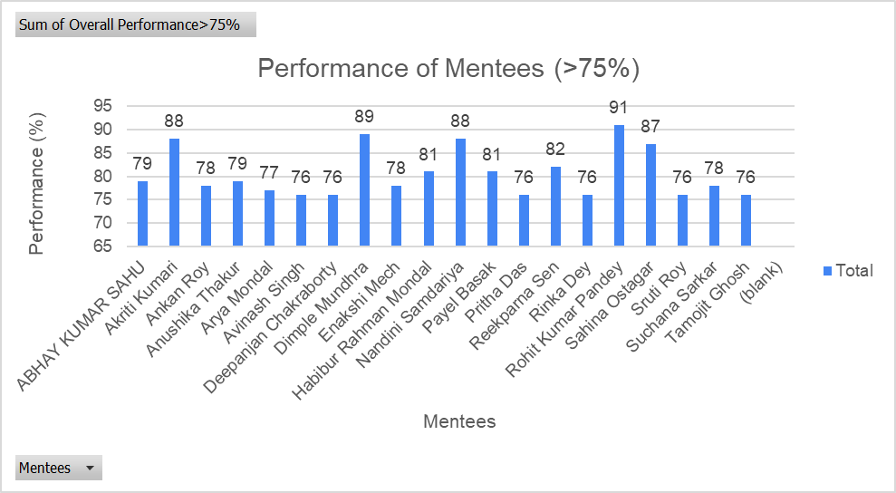

Slide 5
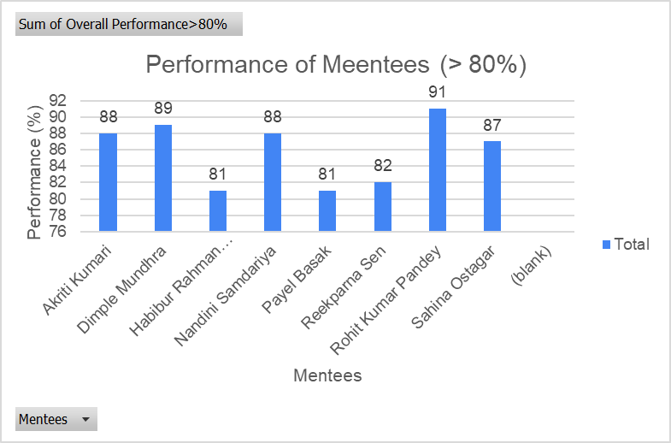

Slide 6
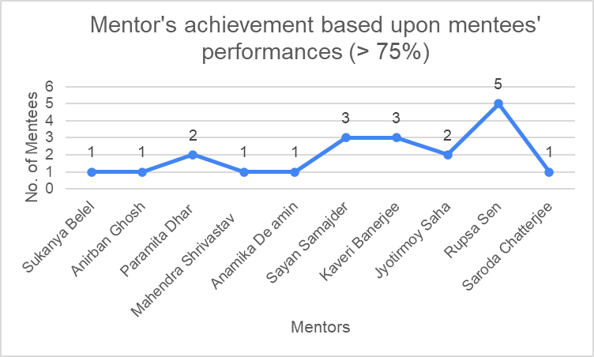

Slide 7
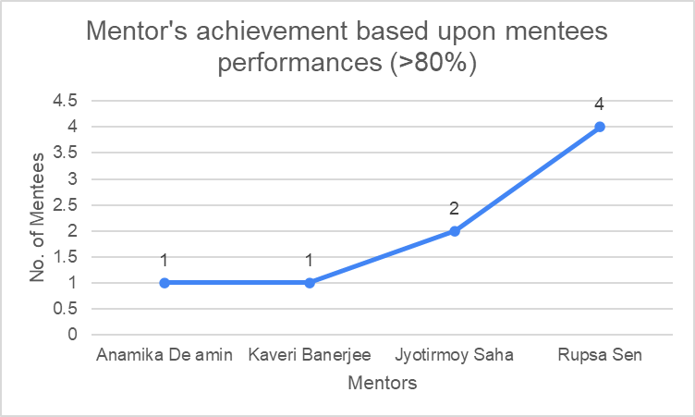

Slide 8
Best performers
(Based upon the mentees performance > 75%)
Mentors | Mentees | No. of mentees > 75% | No. of times better guide
Sukanya Belel | Arya Mondal - BHM 5th | 1 | 1
Anirban Ghosh | Avinash Singh - BHM 5th | 1 | 1
Paramita Dhar | Ankan Roy - BHM 3rd Anushika Thakur - BHM - 3rd | 2 | 2
Mahendra Shrivastav | Enakshi Mech - BHM 3rd | 1 | 1
Anamika De amin | Payel Basak - BHM 3rd | 1 | 1
Sayan Samajder | Pritha Das - BHM 3rd Suchana Sarkar - BHM 3rd Tamojit Ghosh - BHM 3rd | 3 | 3
Kaveri Banerjee | Rohit Kumar Pandey - BCA 5th Sruti Roy - BCA 5th Deepanjan Chakraborty - BCA 3rd | 3 | 3
Jyotirmoy Saha | Akriti Kumari - BCA 5th Dimple Mundhra - BCA 5th | 2 | 2
Rupsa Sen | Nandini Samdariya - BCA 5th Reekparna Sen - BCA 5th Rinka Dey - BCA 5th Sahina Ostagar - BCA - 5th Habibur Rahman Mondal - BCA 3rd | 5 | 5
Saroda Chatterjee | Abhay Kumar Sahoo - BBA 5th | 1 | 1

Slide 9
Best performers
(Based upon the mentees performance > 80%)
Mentors | Mentees | No. of mentees > 80% | No. of times better guide
Anamika De amin | Payel Basak - BBA(HM) 3rd Sem | 1 | 1
Kaveri Banerjee | Rohit Kumar Pandey- BCA 5th Sem | 1 | 1
Jyotirmoy Saha | Dimple Mundhra - BCA 5th Sem | 2 | 2
Rupsa Sen | Nandini Samdariya - BCA 5th Sem Reekparna Sen - BCA 5th Sem Sahina Ostagar - BCA 5th Sem Habibur Rahman Mondal - BCA 3rd Sem | 4 | 4

Slide 10
Thank You!

